Slide 1
Community Data Partnerships in Practice
Notes:
The aim of this presentation is to highlight Commonwealth Government initiatives and projects that address Priority Reform Four, detailed in the next slide.
Importantly, it will showcase examples of how a community data project could be established through this forum and governance group to improve the ways the Morwell Aboriginal community can collect, access, interpret and utilise data for improved outcomes for community.

Slide 2
Priority Reform Four - Shared Access to Data and Information at a Regional Level
Outcome: Aboriginal and Torres Strait Islander people have access to, and the capability to use, locally-relevant data and information to set and monitor the implementation of efforts to close the gap, their priorities and drive their own development.
Target: Increase the number of regional data projects to support Aboriginal and Torres Strait Islander communities to make decisions about Closing the Gap and their development.
More info: https://www.closingthegap.gov.au/national-agreement/priority-reforms
Notes:
Outcome: Aboriginal and Torres Strait Islander people have access to, and the capability to use, locally relevant data and information to set and monitor the implementation of efforts to close the gap, their priorities and drive their own development.
Target: Increase the number of regional data projects to support Aboriginal and Torres Strait Islander communities to make decisions about Closing the Gap and their development.
Partnerships are in place to guide the improved collection, access, management and use of data to inform shared decision-making.
Under this Priority Reform, Governments will:
Share available regional data and information with Aboriginal and Torres Strait Islander organisations and communities.
Establish partnerships between communities and government agencies to improve collection, access, management and use of data, including identifying improvements to existing data collection and management.
Make data more transparent by telling mob what data they have and how it can be accessed and build capacity of organisations and communities to collect, and use data.

Slide 3
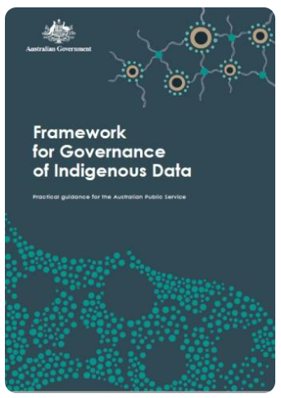
Framework for Governance of Indigenous Data (GID)
Australian Public Service agencies have a single Framework for working with Indigenous data. It offers practical guidance on implementing key aspects of data governance aligned with both Indigenous Data Sovereignty principles and the objectives of the Australian Government.
Commonwealth agencies are expected to develop a seven-year implementation plan, guided by four principles:
Partner with Aboriginal and Torres Strait Islander people
Build data-related capabilities
Provide knowledge of data assets
Build an inclusive data system
Notes:
The framework seeks to move the APS beyond traditional methods of consultation, to ensure Aboriginal and Torres Strait Islander people have an equal position at the decision-making table on matters affecting them.
Implementation of the Framework will support efforts to implement the National Agreement on Closing the Gap, in particular Priority Reform Three (Transforming Government Organisations) and Priority Reform Four (Shared Access to Data and Information at a Regional Level).
Commonwealth agencies are expected to develop a seven-year implementation plan, guided by four principles:
Partner with Aboriginal and Torres Strait Islander people at all stages of the data lifecycle to ensure their priorities are reflected in data about their communities.
Build data-related capabilities of APS staff and Aboriginal and Torres Strait Islander partners relating to Indigenous data across the data lifecycle.
Provide knowledge of data assets by developing straightforward methods for Aboriginal and Torres Strait Islander people to know what data are held relating to their interests, its use, and how it can be accessed.

Slide 4
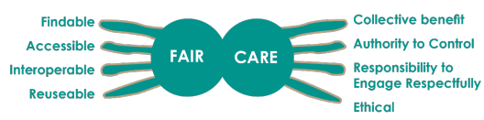
Framework for Governance of Indigenous Data (GID)
The Framework is based on the principles of respect for cultural heritage, informed consent, privacy, and trust. It is informed by FAIR (Findable, Accessible, Interoperable, and Reusable) guiding principles on data management and CARE (Collective Benefit, Authority to Control, Responsibility, Ethics) principles which reflect the crucial role of data in self-determination.
Each guideline is governed by the actions of prepare, grow and extend.
More info: https://www.niaa.gov.au/resource-centre/framework-governance-indigenous-data
Notes:
The Framework is based on the principles of respect for cultural heritage, informed consent, privacy, and trust.
It is informed by FAIR (Findable, Accessible, Interoperable, and Reusable) guiding principles on data management and CARE (Collective Benefit, Authority to Control, Responsibility, Ethics) principles which reflect the crucial role of data in self-determination.

Slide 5
National Agreement on Closing the Gap – Community Data Projects
The aim of the Community Data Projects is to support participating Aboriginal and Torres Strait Islander organisations and communities to:
  better use the data and information that they already collect
  better access and use the data and information that government collects
  collect and interpret data that they consider important to their own development
  share decision-making with governments about the future of their communities based on a better understanding about what is happening and how policies and programs are working
  drive and monitor progress on Closing the Gap
  strengthen the capacity of participating community-controlled organisations to develop local solutions in their communities measure the effectiveness of mainstream organisations delivering services across each of the six project sites and agree with governments about areas for change
  be empowered to grow their knowledge and evidence base to ensure they ‘tell the story’ of their data
  bring light to the stories of different groups within the Aboriginal and Torres Strait Islander population, including Aboriginal and Torres Strait Islander stolen generation survivors, people with disability, and LGBTIQA+SB people, to help improve the lives of all Aboriginal and Torres Strait Islander peoples.
Notes:
The National Agreement on Closing the Gap (National Agreement) includes a commitment to establish Community Data Projects in six locations across Australia. The Community Data Projects are part of Priority Reform Four in the National Agreement.
The Community Data Projects will support regional shared decision-making on Closing the Gap between participating Aboriginal and Torres Strait Islander organisations and communities and governments based on better access to and use of data about what is happening in each of the six project sites, one of which is Gippsland.
The aim of the Community Data Projects is to support participating Aboriginal and Torres Strait Islander organisations and communities to:
better use, access and interpret the data and information that they already collect and that government collects
share decision-making with governments about the future of their communities based on a better understanding about what is happening and how policies and programs are working
drive and monitor progress on Closing the Gap
be empowered to grow their knowledge and evidence base to ensure they ‘tell the story’ of their data
bring light to the stories of different groups within the Aboriginal and Torres Strait Islander population, including Aboriginal and Torres Strait Islander stolen generation survivors, people with disability, and LGBTIQA+ people.
The Australian Institute of Health and Welfare (AIHW) will build a Community Data Portal for each Community Data Project. The Community Data Portal will help participating Aboriginal and Torres Strait Islander organisations access data about ‘Closing the Gap’ in their region.

Slide 6
National Agreement on Closing the Gap – Community Data Projects
There will be four start up stages of each Project:
  Agreeing overarching partnership and shared decision making arrangements on Closing the Gap between participating Aboriginal and Torres Strait Islander organisations and governments
  Agreeing data sharing arrangements, establishing a baseline of data in the Community Data Portal and setting up accounts for participating organisations
  Training participating organisations on how to use the Community Data Portal
  Agreeing shared priorities for action and monitoring
In 2025 the parties to the National Agreement will meet to consider the progress of the projects and consider additional actions.
More info: https://www.niaa.gov.au/our-work/closing-gap/closing-gap-community-data-portals
Notes:
There will be four start up stages of each Project:
Agreeing overarching partnership and shared decision making arrangements on Closing the Gap between participating Aboriginal and Torres Strait Islander organisations and governments
Agreeing data sharing arrangements, establishing a baseline of data in the Community Data Portal and setting up accounts for participating organisations
Training participating organisations on how to use the Community Data Portal
Agreeing shared priorities for action and monitoring
In 2025 the parties to the National Agreement will meet to consider the progress of the projects and consider additional actions.
Optional mention – Development and implementation of the Community Data Projects and Portal are running behind the expected delivery timelines and engagement with community and stakeholders in Gippsland has been lacking to date. The Agency is looking to re-engage in this space and hopes that through this forum and partnership there may be further opportunity to do so, given the topic of community data is of such a high priority to the region.

Slide 7
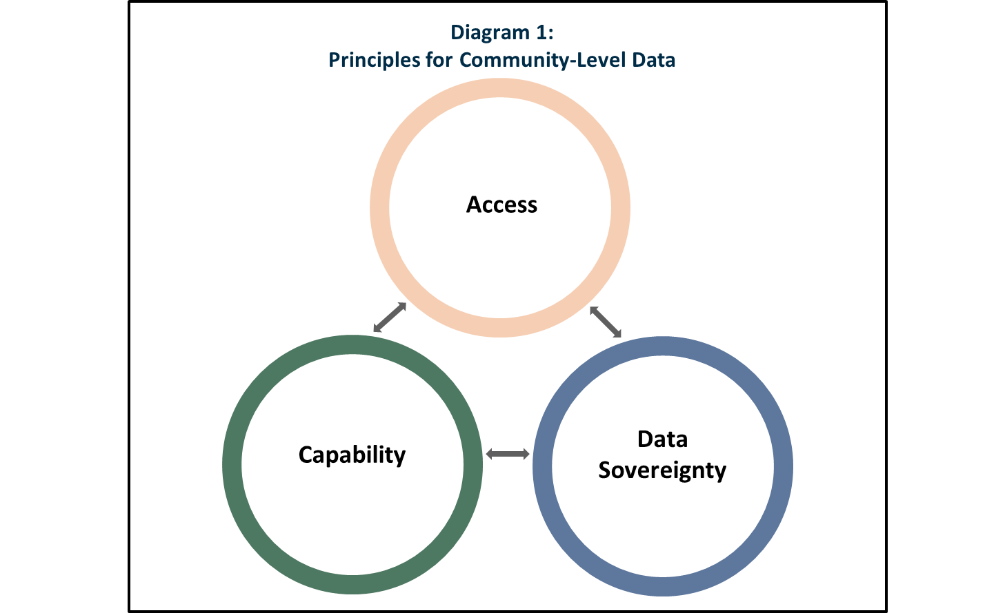
The Community Data Toolkit
Principles for community-level data – Pillar One
  access, that Government should aspire towards making community data accessible as a default;
  capability, that stakeholders should support community confidence and capability to do meaningful data work; and
  data sovereignty, that First Nations and community data sovereignty should be championed wherever feasible.
Finding community-level data – Pillar Two
  This resource will function as a library to link to selected relevant Commonwealth data. It may also include state, territory, and local government data where appropriate.
Interpreting community-level data – Pillar Three
  Toolkit will assist by outlining the resources that are currently available to support data interpretation by communities, Government, and other stakeholders at various levels of data maturity.
  These may include examples of how final data products have been produced by experienced data analysts working across Government.
Sharing community-level data – Pillar Four
  Toolkit will provide entry level information on how data sharing works under current arrangements, while providing some pathways to address potential roadblocks.
More info:
Notes:
As part of the Targeting Entrenched Disadvantage package, Treasury has been undertaking work to support putting data in the hands of communities to enable local decision making.
The Community Data Toolkit will focus on supporting stakeholders to find, interpret and share community-level data.
The Toolkit will be delivered as a series of web-based resources geared around four key deliverables. The aim is to make these resources initially available from December 2024.
Principles for community-level data – Pillar One
The community data principles will outline a ‘best practice’ for working at the community data level, ensuring that better outcomes are achieved for both community and broader stakeholder groups. While the principles will be refined through further consultation, they are currently framed around:
access, that Government should aspire towards making community data accessible as a default;
capability, that stakeholders should support community confidence and capability to do meaningful data work; and
data sovereignty, that First Nations and community data sovereignty should be championed wherever feasible.
Finding community-level data – Pillar Two
While some Government departments provide data at the community-level, this data can be hard to find and difficult to interpret.
This resource will function as a library to link to selected relevant Commonwealth data, it may also include state, territory, and local government data where appropriate.
By making the environment easier to navigate, this resource will increase the impact Commonwealth data resources can have.
Interpreting community-level data – Pillar Three
There can be a substantial knowledge gap in understanding how to transform publicly available data into end products such as reports and data visuals.
This resource will assist by outlining the resources that are currently available to support data interpretation for everyone.
Sharing community-level data – Pillar Four
Data sharing arrangements across Government can be hard to understand and navigate.
This is especially the case for community-level organisations seeking to engage with relevant data custodians working in Commonwealth departments.
This resource will provide entry level information on how data sharing works under current arrangements, while providing some pathways to address potential roadblocks.

Slide 8
Questions?

